Slide 1
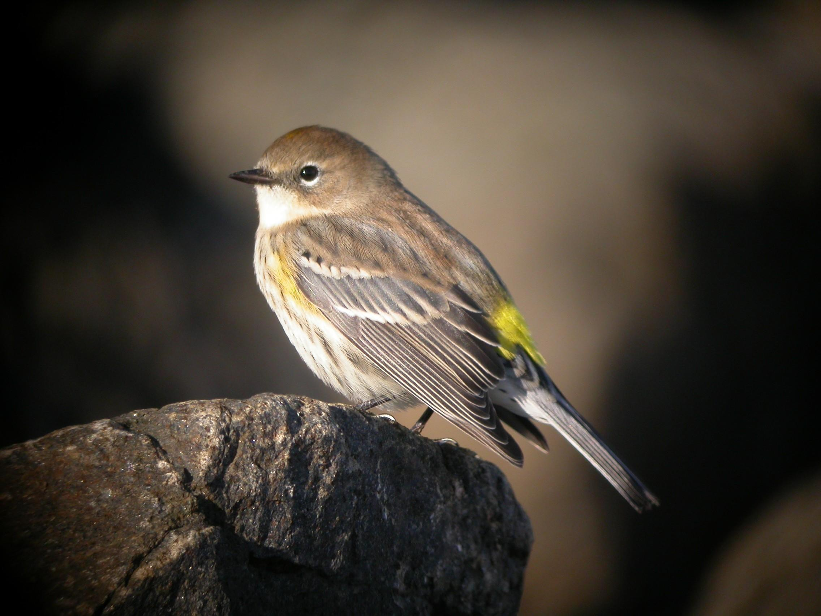
Bird Watching 101
A beginners guide

Slide 2
How to Identify a bird Using Peterson’s Field Guide
Birds are grouped into eight main visual categories
Swimmers: Ducks and ducklike birds
Aerialists: Gulls and gull-like birds.
Long-legged Waders: Plovers, sandpipers, etc.
Fowl-like Birds: Grouse, quail, etc.
Birds of Prey: Hawks, eagles, owls.
Non-perch Birds
Perch Birds
Not based on any phylogenetic or systematic order.

Slide 3
How to Identify a bird Using Peterson’s Field Guide
What is the birds size?
Yardstick species- smaller than a house sparrow, a robin, a pigeon etc.

Slide 4
How to Identify a bird Using Peterson’s Field Guide
What’s is its shape?
Is it plump like a starling, or slender like a cuckoo?

Slide 5
How to Identify a bird Using Peterson’s Field Guide
Thrushes, Flycatchers, Hawks, Owls, and shore birds
Vireos, Shrikes, Crows and Warblers

Slide 6
How to Identify a bird Using Peterson’s Field Guide
What shape are its wings?
Are they rounded like those of a quail orsharply pointed like those of a barn swallow?

Slide 7
How to Identify a bird Using Peterson’s Field Guide
What shape is its bill?
Is it small and fie like a warbler, stout and short like a seed cracking sparrow’s dagger shaped like a tern’s, or hook-tipped like that of a bird of prey.

Slide 8
How to Identify a bird Using Peterson’s Field Guide
What shape is its tail?
Is it deeply forked like a Barn Swallow’s, square-tipped like a Cliff Swallow’s, notched like a Tree Swallow’s, rounded like a jay’s, or pointed like a Mourning Dove’s

Slide 9
How to Identify a bird Using Peterson’s Field Guide
How does it behave?
Does it cock its tail like a wren or hold it down like a flycatcher? Does it wag, flip or dip its tail? Etc.

Slide 10
How to Identify a bird Using Peterson’s Field Guide
Does it climb trees?
If so, how does it climb? Does it spiral, in jerks using its tail as a brace, or head first?

Slide 11
How to Identify a bird Using Peterson’s Field Guide
How does it fly?
Does it swoop up and down? Fly fast and straight? Or hover? Does it glide or soar?

Slide 12
How to Identify a bird Using Peterson’s Field Guide
Does it swim?
Does it sit low or high in the water? Does it dive or bob for food?

Slide 13
How to Identify a bird Using Peterson’s Field Guide
Does it wade?
Does it have long legs, or short legs? Does it probe the mud or pick at things?

Slide 14
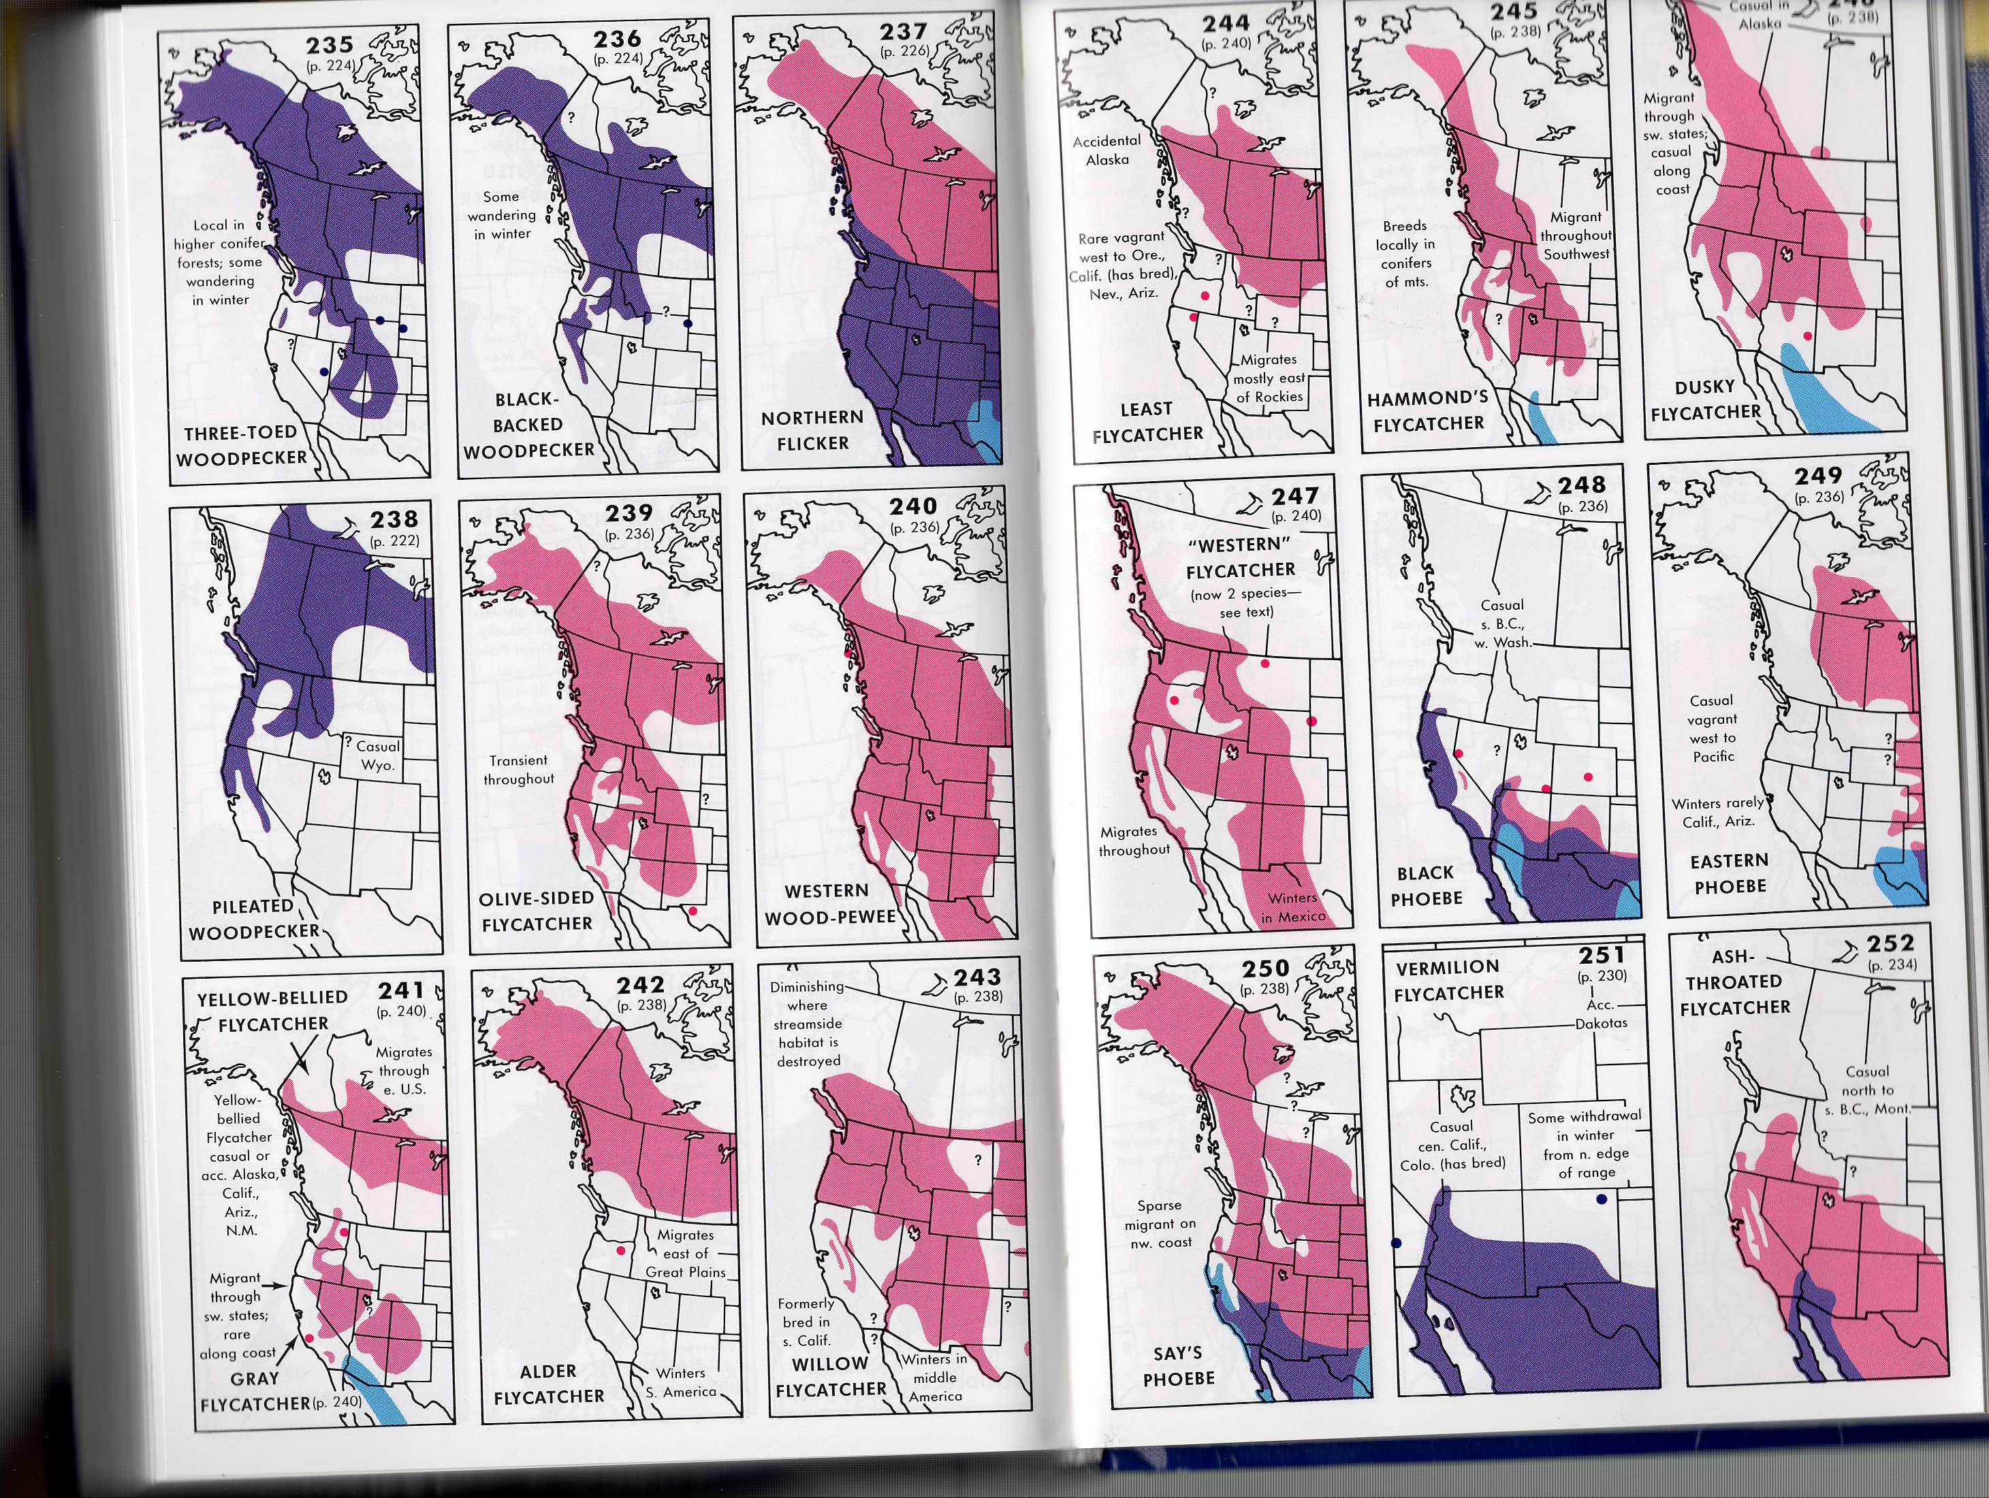
How to Identify a bird Using Peterson’s Field Guide

Slide 15
Can you spot the difference?
Western Gull
California Gull
Hint: Look at the feet.

Slide 16
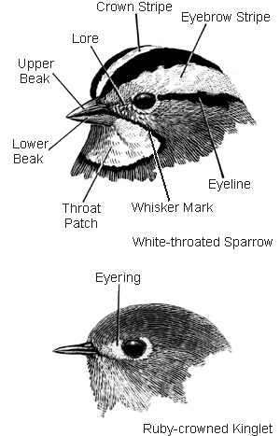
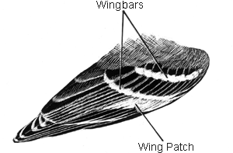
Field Markings

